Slide 1
Decision Support System for Hospital Management
Tracking Admission Rates, Doctor Availability, and Treatment Effectiveness
K. Siva Naga Manoj Kumar(192111630)

Slide 2
Introduction
Definition of DSS: A Decision Support System (DSS) is a computer-based system designed to support decision-making by analyzing data and providing actionable insights.
Importance in Healthcare: In healthcare administration, a DSS enhances decision-making, streamlines operations, and improves the quality of patient care.
Purpose of DSS: The goal is to develop a DSS for hospital management that tracks key metrics such as patient admission rates, doctor availability, and treatment effectiveness.
Impact on Hospital Operations: The DSS will help improve hospital resource allocation, reduce wait times, and optimize patient care in a hospital handling over 10,000 patient records

Slide 3
Importance of DSS in Healthcare
Informed Decision-Making: DSS enables healthcare administrators to analyze large volumes of data, leading to better and more informed decision-making.
Improved Patient Outcomes: By providing insights into treatment effectiveness and patient trends, DSS helps healthcare providers offer personalized and effective care, leading to better patient outcomes.
Optimized Resource Allocation: DSS helps healthcare organizations manage resources (beds, staff, medical equipment) more efficiently, reducing waste and ensuring availability where needed.
Cost Reduction and Operational Efficiency: DSS identifies inefficiencies in hospital operations, enabling cost-saving measures and improving the overall efficiency of healthcare delivery.
Adaptation to Changing Environments: DSS enables healthcare facilities to quickly adapt to changes such as patient influxes, medical advancements, and regulatory requirements, ensuring smooth operations in dynamic environments.

Slide 4
SOFTWARE REQUIREMENTS
Database Management System (DBMS) – SQL, PostgreSQL, or MySQL for storing patient records.
Business Intelligence Tools – Tableau, Power BI, or Google Data Studio for data visualization.
Programming Languages – Python, Java, or R for data processing and analysis.
Machine Learning Frameworks – TensorFlow, Scikit-Learn, or PyTorch for predictive analytics.
Web Technologies – HTML, CSS, JavaScript, React for building dashboards.
Cloud Services – AWS, Azure, or Google Cloud for secure data storage and processing.

Slide 5
HARDWARE REQUIRMENTS
Servers – High-performance servers for hosting the DSS application and databases.
Storage Devices – SSDs or cloud storage for secure data management.
Workstations – Computers for doctors, nurses, and hospital administrators to access DSS.
Networking Equipment – Routers, switches, and high-speed internet for seamless data communication.
IoT Devices – Smart sensors and patient monitoring systems for real-time data collection.

Slide 6
Implementation Strategy
• Database setup using SQL for patient records.
• Integration with Business Intelligence tools for analysis.
• Real-time dashboards for monitoring hospital operations.
• Data analytics for improving treatment effectiveness.
• Automated alerts for resource shortages.
• Machine learning models for predictive healthcare analytics.

Slide 7
Implementation Process
Content:
System Design & Planning: Identifying requirements and defining the architecture of the DSS.
Data Integration: Integrating hospital management systems with DSS for real-time data.
Algorithm Development: Creating algorithms to track patient admission rates, doctor availability, and treatment outcomes.
Testing & Quality Assurance: Ensuring that the DSS works effectively under real-world conditions.
Training: Training hospital staff to use the DSS effectively.
Deployment: Rolling out the DSS to all hospital departments.

Slide 8
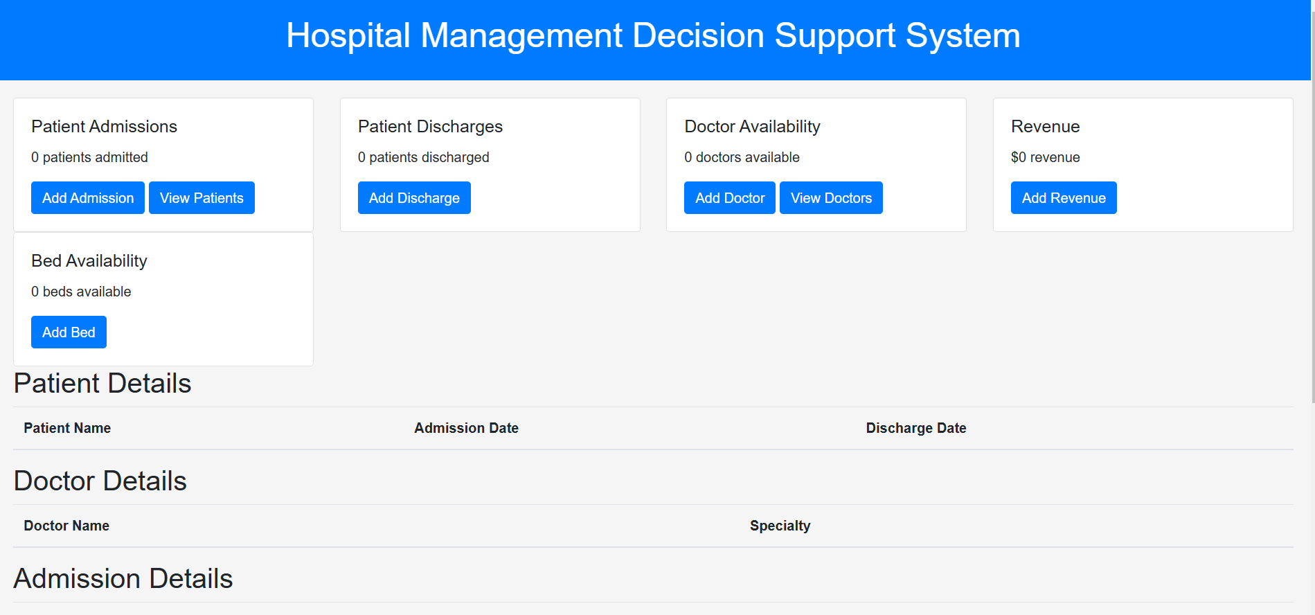
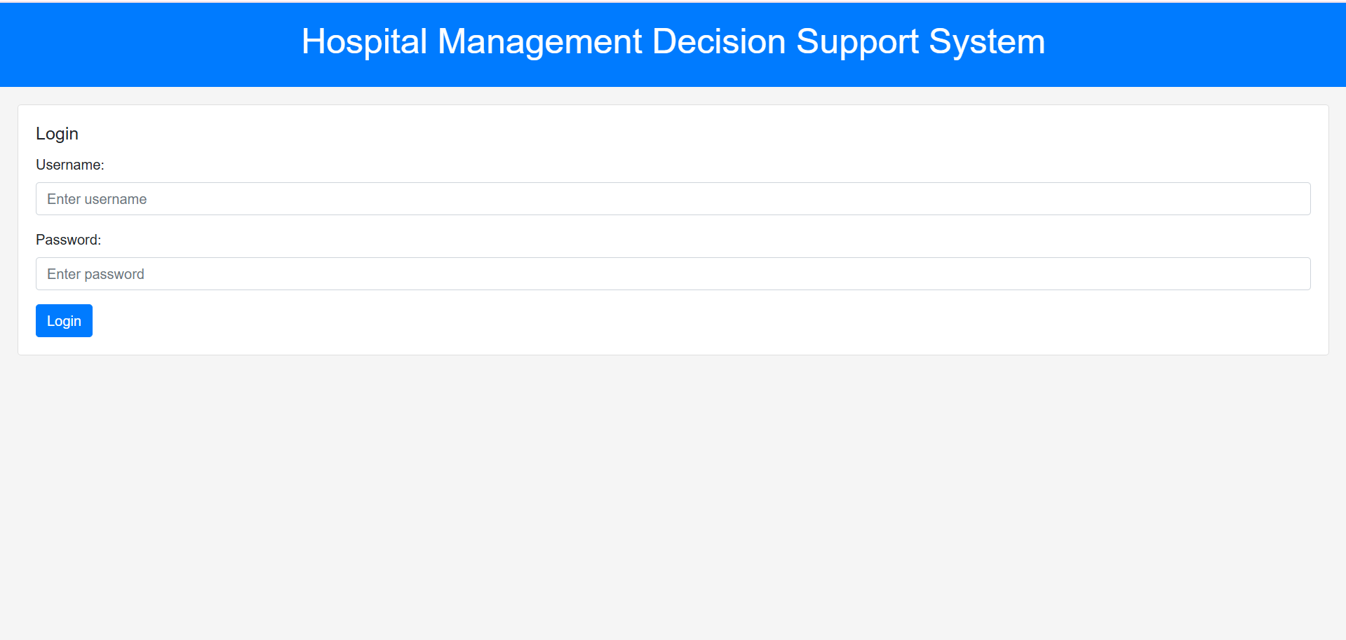
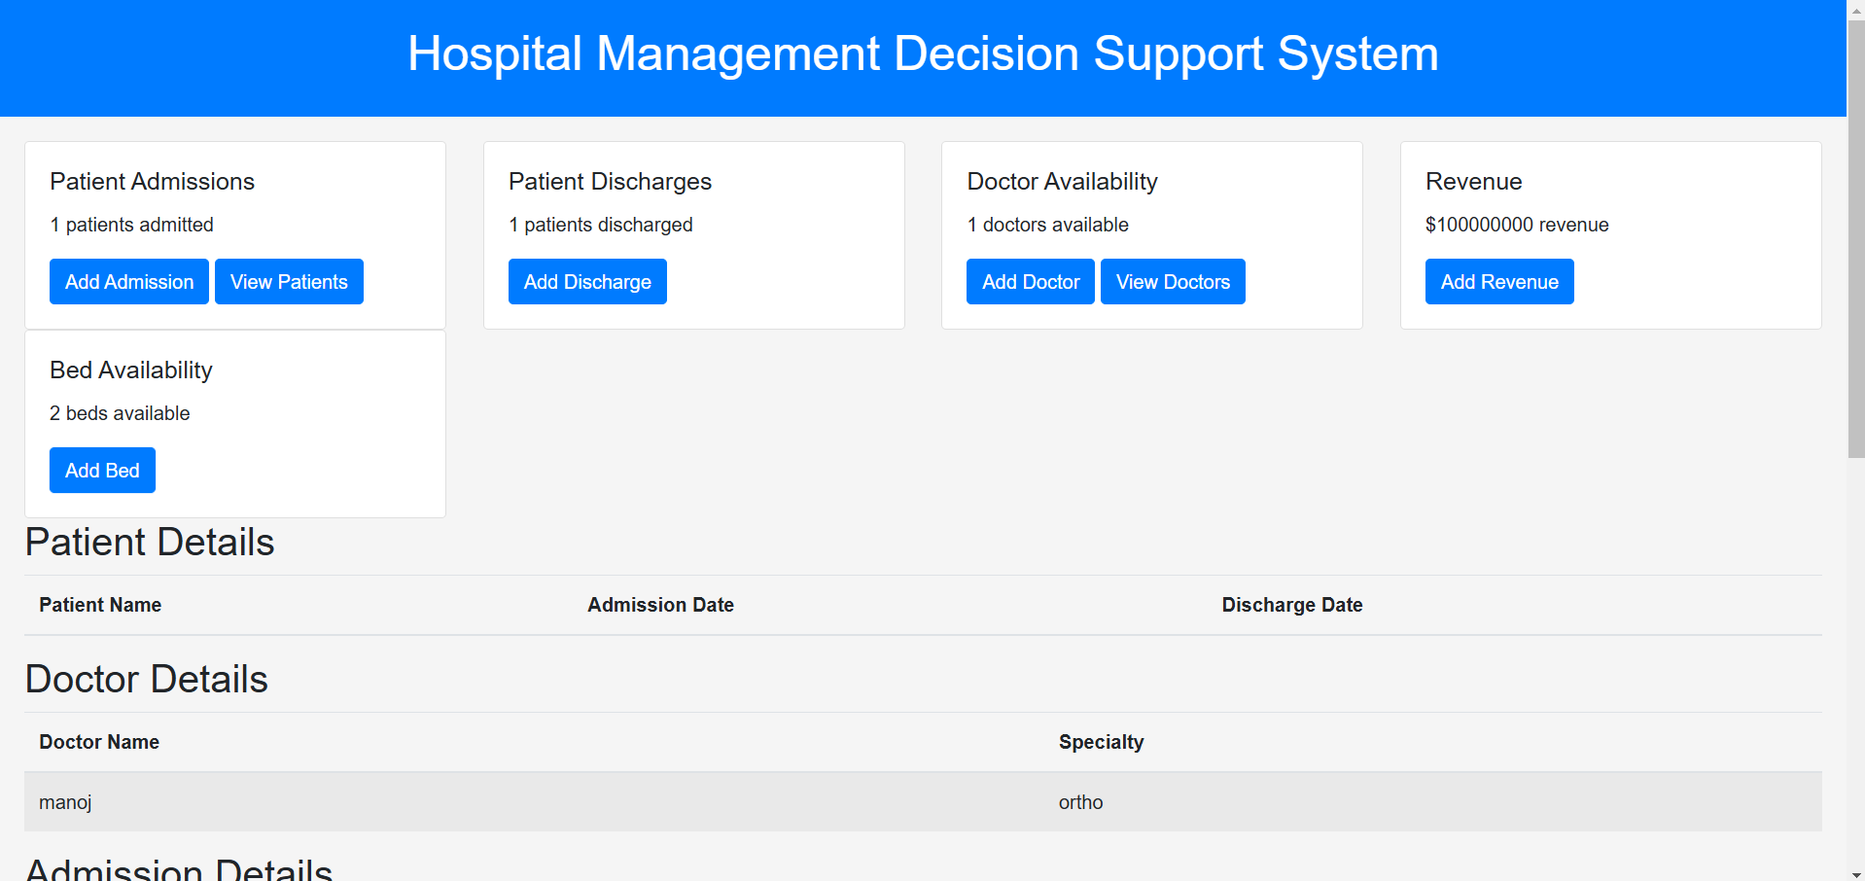
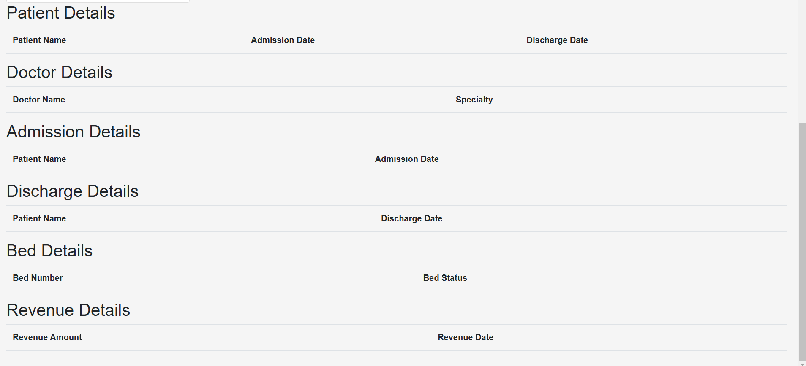
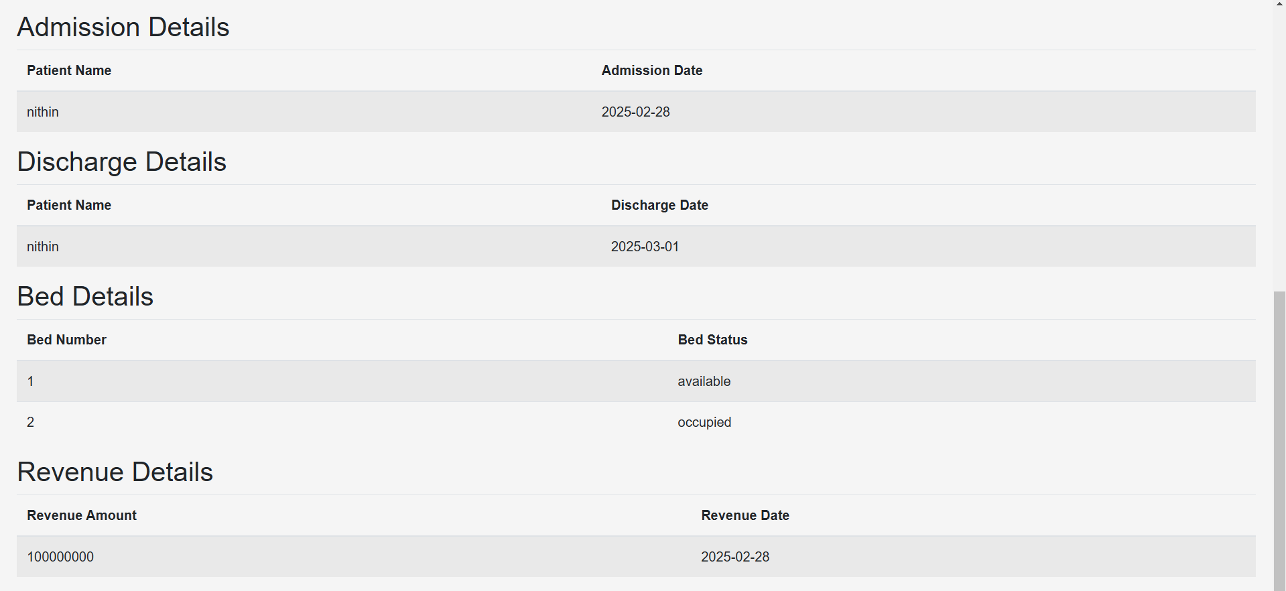
OUTPUT

Slide 9
Benefits of DSS in Healthcare
• Efficient patient and resource management.
• Reduced wait times for patients.
• Enhanced decision-making for hospital administration.
• Improved treatment effectiveness based on data insights.
• Cost reduction through better resource utilization.
• Increased patient satisfaction and hospital reputation.

Slide 10
Conclusion
• A well-implemented DSS improves hospital efficiency.
• Optimizes resource allocation and enhances patient care.
• Helps hospitals make data-driven decisions for better outcomes.
• Supports scalability and future expansion.
• Ensures regulatory compliance and data security.
• Enhances collaboration between hospital departments.

Slide 11
THANK YOU

